Slide 1
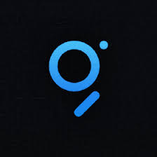

Slide 2
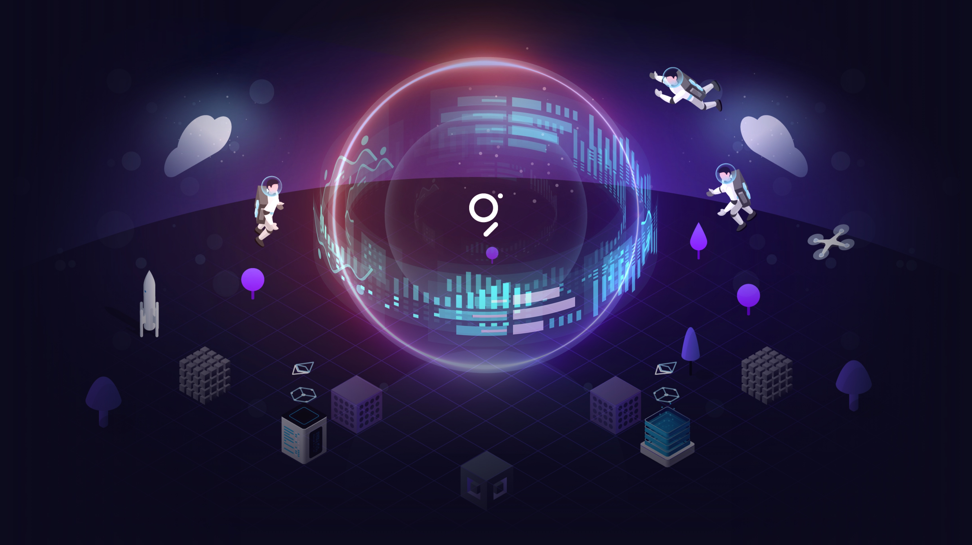
The Graph
The Google of the Blockchain
Notes:
graphQL was created by Facebook / Meta so we can wonder if it's really gonna get free from it and be really decentralized

Slide 3
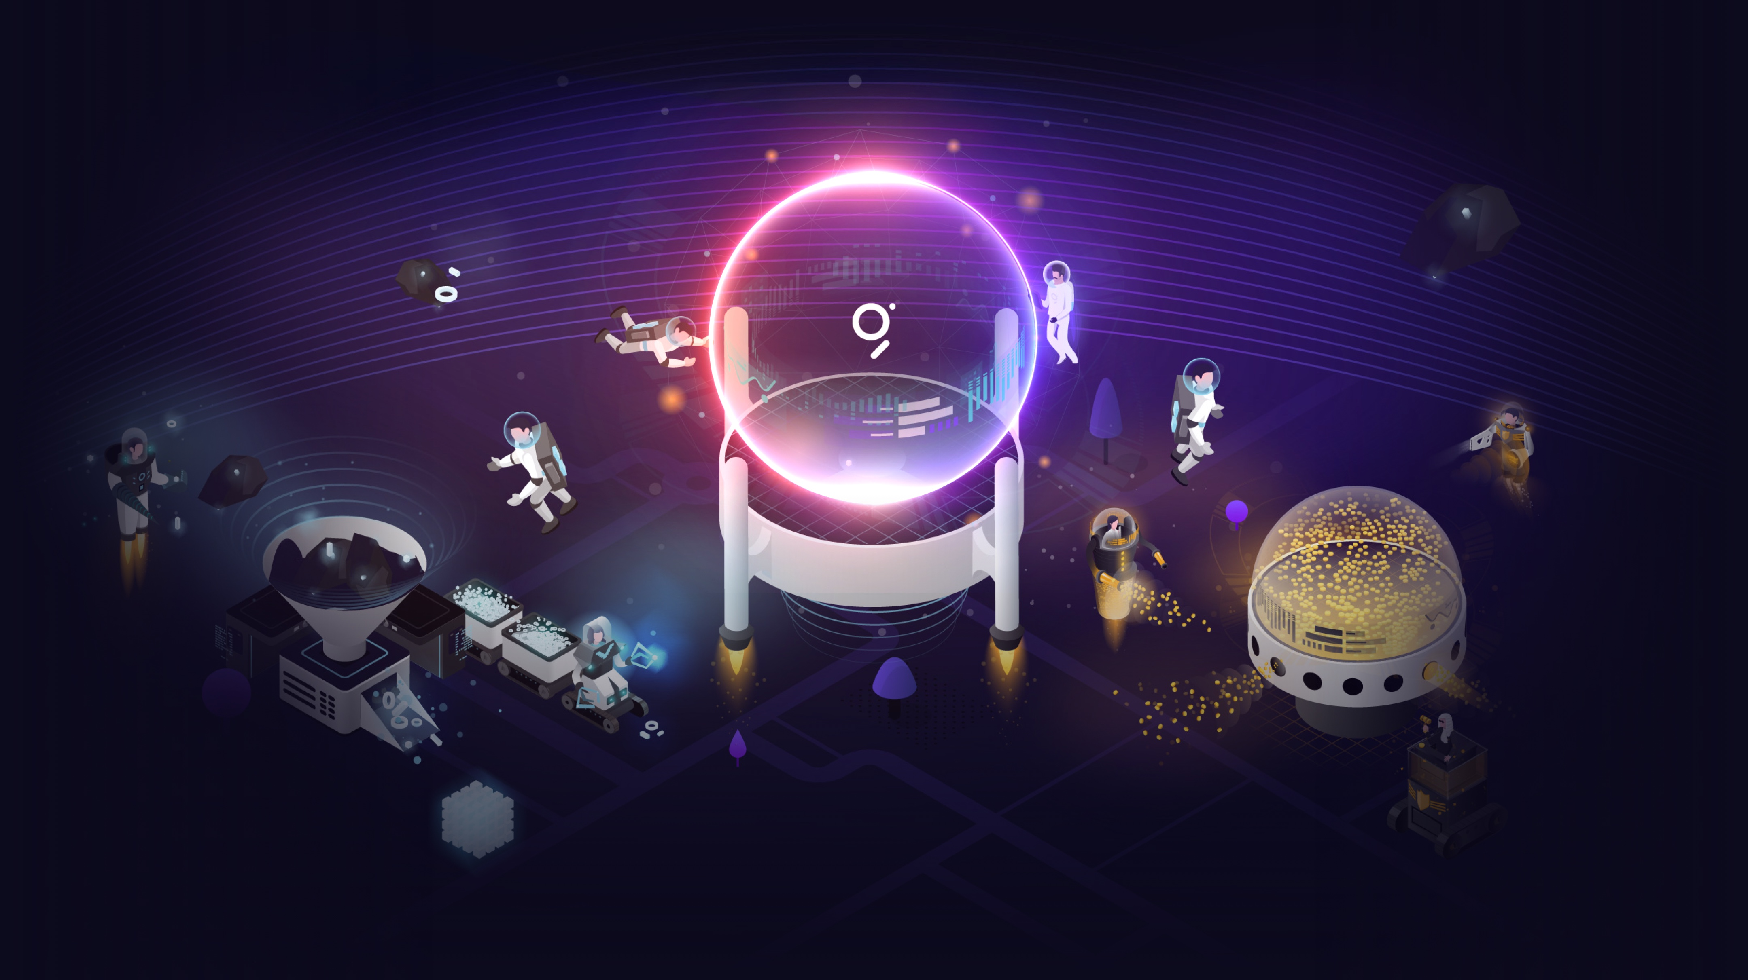
What is the Graph?

Slide 4
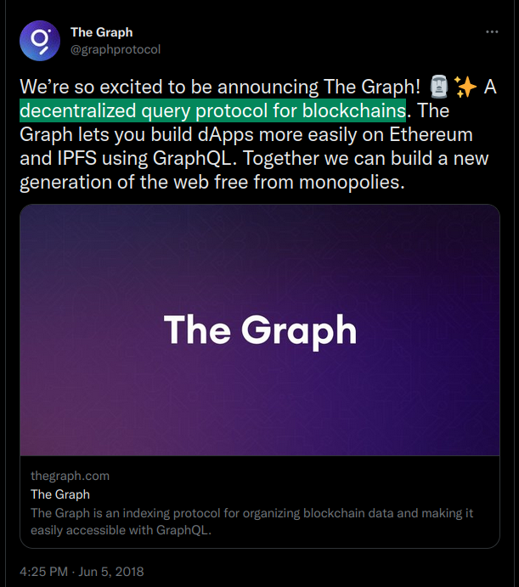
Notes:
﻿A query can give you an answer to a simple question, perform calculations, combine data from different tables, add, change, or delete data from a database.

Slide 5
Query
request for data results from your database
request for action on the data, or for both
A tool to help
Can answer a simple question
Search, find and work with your data
→ Search Bar

Slide 6
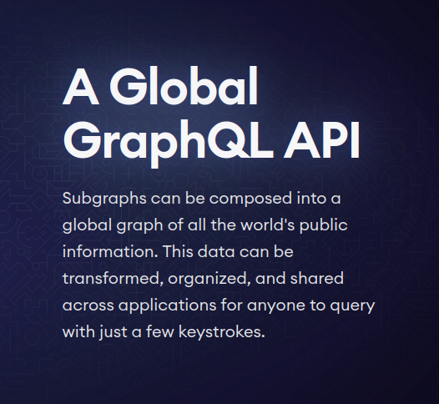
Notes:
The reason why it became so quickly successful is because it's cheap and even free depending what you need.
Of course you get all the quotes and information on their official website which is really well-made

Slide 7
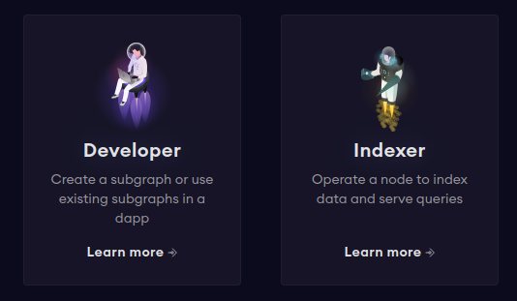
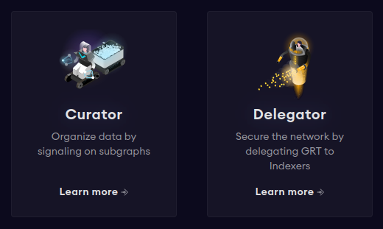
The Graph ?
Who uses
Notes:
I’m not gonna elaborate too much on it because of time and also because what I want you to know is that it’s mainly for us developer and we can also contribute to it by becoming an indexer etc..

Slide 8
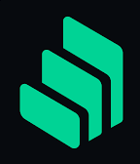
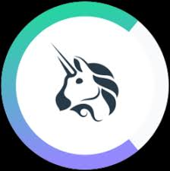
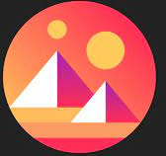
Compound
Uniswap
decentraland
Notes:
These are just an example of the many DEX (decentralised ethereum-based crypto exchange)
DeFi (decentralised finance), or just Dapp

Slide 9
To sum up
a Browser for Ethereum and IPFS
Decentralized indexing protocol for Web3
Uses GraphQL API (Application Programming Interface)
Useful for Developers and Indexers
Notes:
The Graph Network
IPFS InterPlanetary File Storage -> it's a system that isnt location based but content based so it uses The Graph with the GraphQL lannguage
whatyou want -> it uses the hash and was created by file coin
Because you can Find quickly useful information from several blockchain network

Slide 10
Why?
Not the only one to do so
Etherscan / Avascan do so too etc…
enable comparisons for humans of more than 20 networks (Ethereum, Binance Blockchain, Avalanche, Moonbeam etc... )
Enhance compatibility between blockchains networks
Easier to program and create DeFi

Slide 11
Before the Graph
Gather yourself all the data
Requires days
Indexing blockchain data is really, really hard.
https://thegraph.com/docs/en/about/
Notes:
before the graph -> caveman style

Slide 12
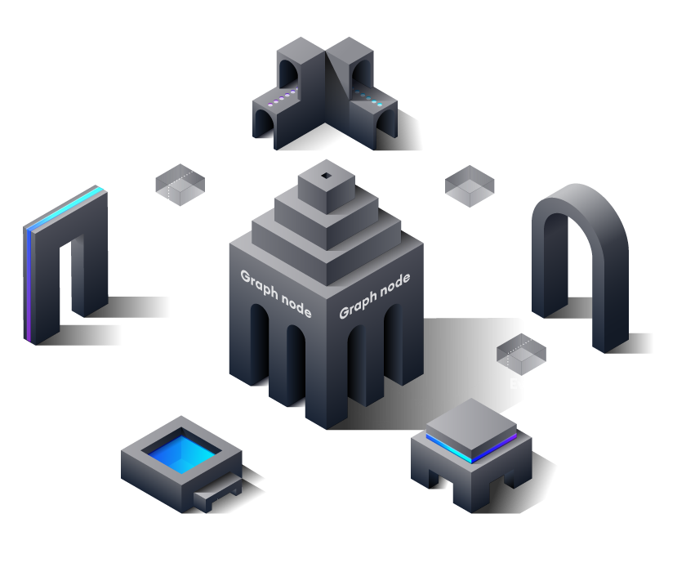
How it works
Notes:
The flow follows these steps:
A decentralized application adds data to Ethereum through a transaction on a smart contract.
The smart contract emits one or more events while processing the transaction.
The software Graph Node is an open source software that you can find on GitHub. It continually scans Ethereum for new blocks and the data for your subgraph they may contain.
Graph Node finds Ethereum events for your subgraph in these blocks and runs data you provided. it then stores these datas in the Graph Node in response to Ethereum events.
When The decentralized application / Dapp needs Data they queries the Graph Node for data indexed from the blockchain by using the node's GraphQL endpoint.
The Graph Node in turn makes accessible the data by translating the GraphQL queries into queries including all the datas of the store.
Then the dapp displays this data in a user-friendly rich UI for end-users, which they use to issue new transactions on Ethereum.
The cycle repeats.

Slide 13
How to use?
Not so hard → no need to be a pro
Official webpage
YouTube Tutorial

Slide 14
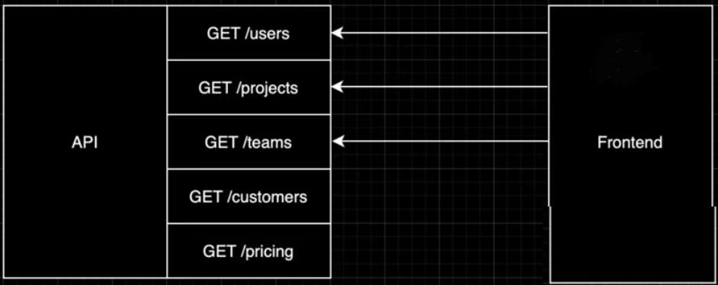
Notes:
many endpoints and you dont have access to all the data you need so it's slow because you have to go kind of one by one

Slide 15
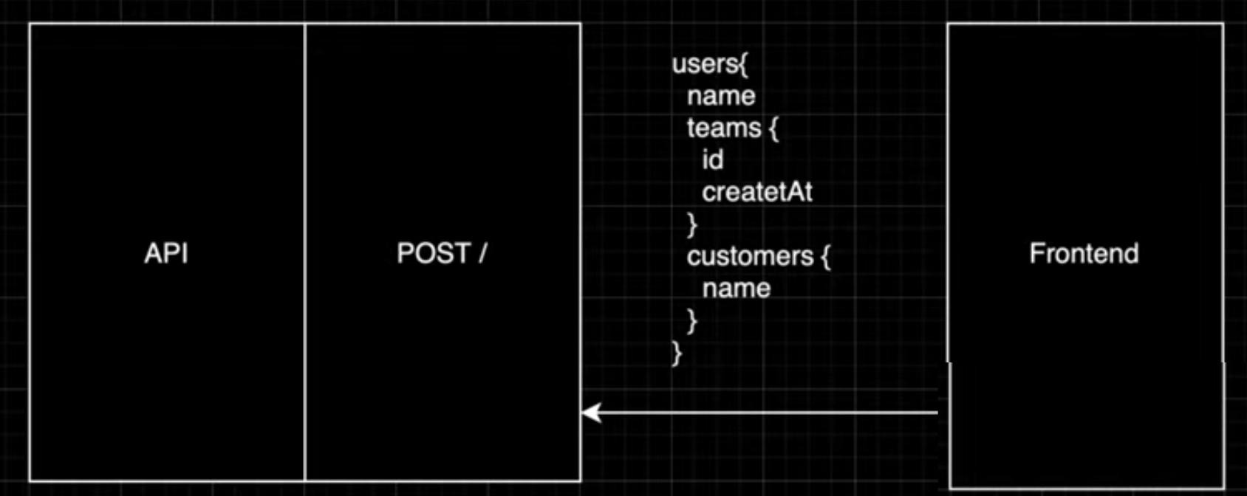
Notes:
with GraphQL you have a single endpoint for all the route so it's quick because you can look for several data from multiple routes at once
We're gonna focus on how the Graph works to build Ethereum Defi and API

Slide 16
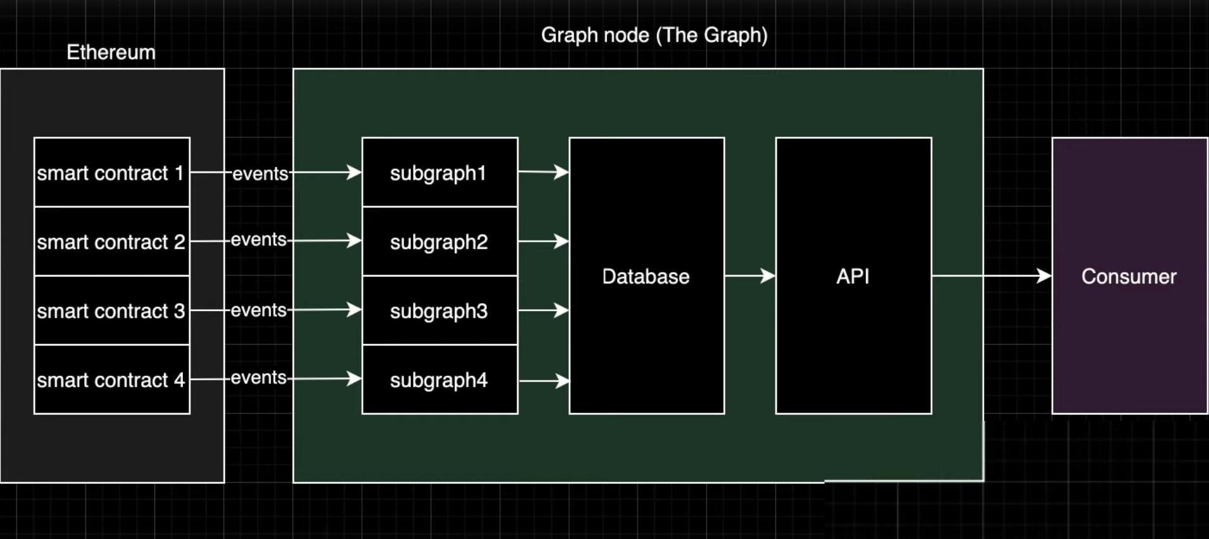
How to build API for Ethereum
Notes:
Subgraph -> combination of datas you're looking for in the Blockchain.
Most of the case you’ll be looking for a Smart-Contracts event
We’ll see later what data in the event you can find.
You’ll also be looking for it's availability for consumers so that it’s easily accessible for the consumer / developer to query this data.
The cool thing is that everybody can add its own subgraph and the merrer the better.
Of course since it's based on a the SC it is immutable which adds to lyability and value.
To use the Graph you use the software call Graph Node that you can see here and talked about earlier.
It uses the Rust language to code

Slide 17
Sources
https://thegraph.com/en/
https://www.youtube.com/watch?app=desktop&v=l2rzT_Dp4T0

